Slide 1

Notes:
Kenneth

Slide 2
Going hungry in a hospital?
It’s easier than you think.
Notes:
Kenneth ( can mention a few numbers)

Slide 3

Malnourished patient:
Hospitalized 4 days longer
56% higher chance of readmission
5x as likely to die during a stay
Notes:
Omar

Slide 4
Top 3 hospital quality metrics:
Length of Stay
Readmission Rates
Mortality Rates
Notes:
Omar

Slide 5
Introducing
An AI driven, image detection system designed to combat malnutrition in hospitals
Notes:
Omar

Slide 6

Notes:
Omar

Slide 7
Value Proposition:
“Helping to prevent hunger one byte at a time”
At each meal, MalPal identifies what food is on the plate, then determines how much has been eaten
If patient consumes less than 50% of portion over 4 days, MalPal alerts hospital staff
Notes:
Omar

Slide 8
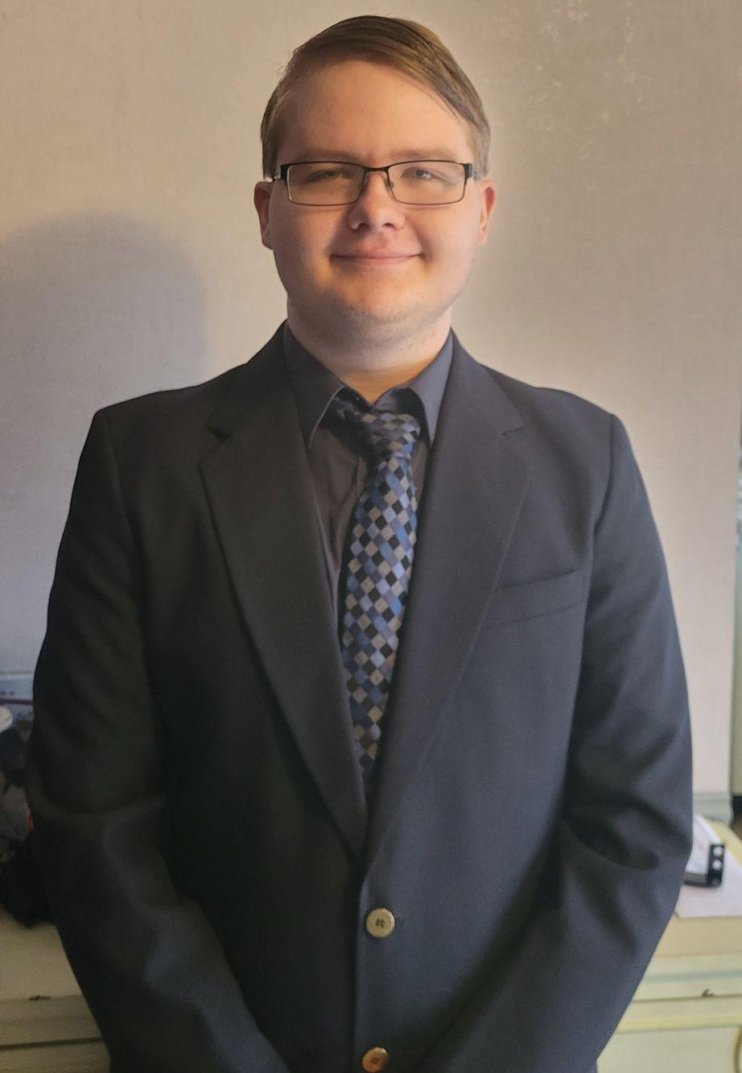

RoBiOtics, Inc.
CEO: Kenneth Cochran
CFO: Joe Siapno
Notes:
Kenneth, joe, omar

Slide 9
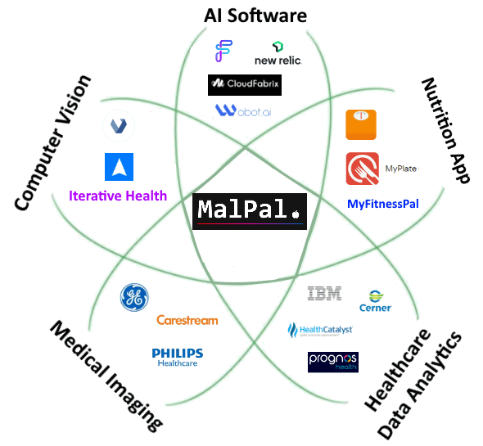
Notes:
Omar

Slide 10
Intellectual Property
Logo - trademarked
Training database - copyright pending
Trade secrets
Notes:
Kenneth

Slide 11
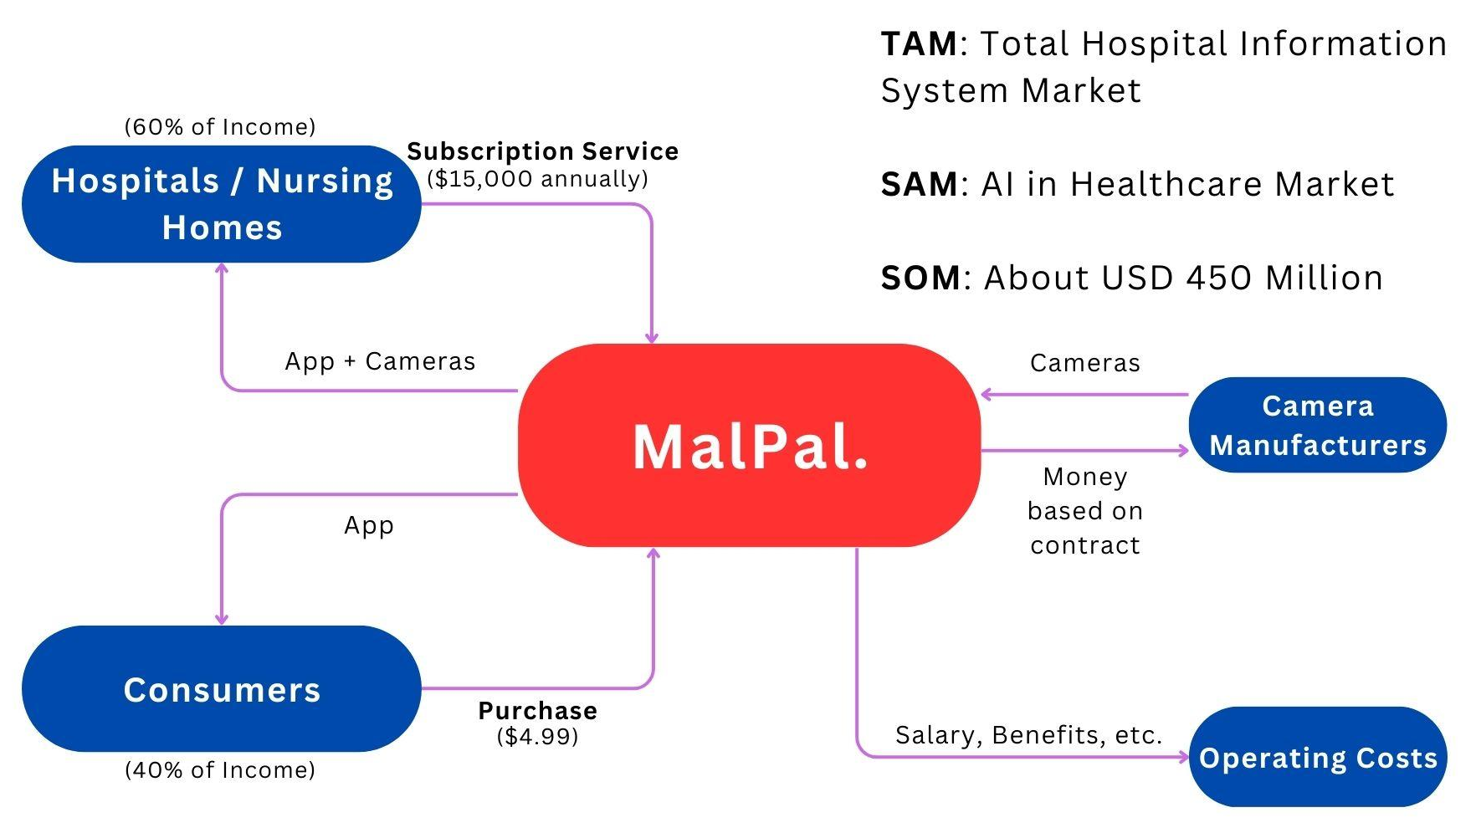
Notes:
Joe

Slide 12
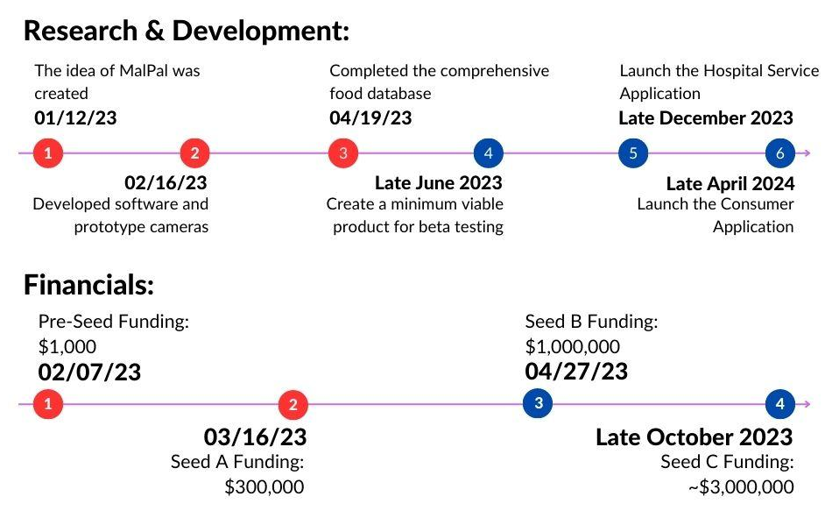
$1,000,000 and offer 20% shares
Notes:
Joe (SHARES ARE PREFERENTIAL SHARES)

Slide 13
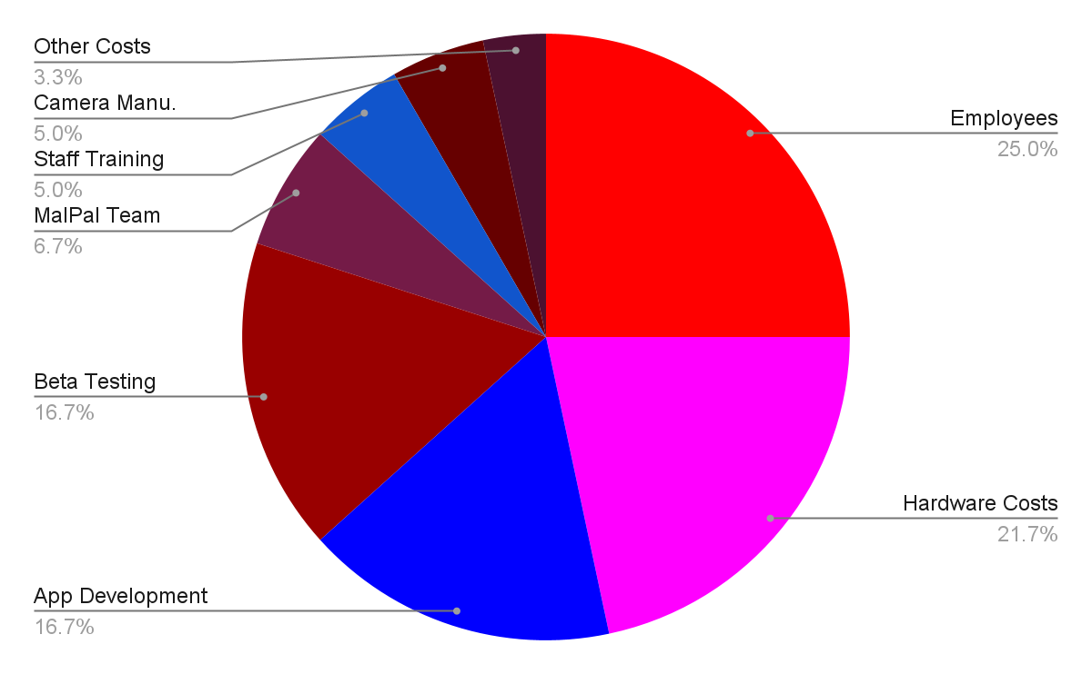
Budget
Notes:
Joe

Slide 14
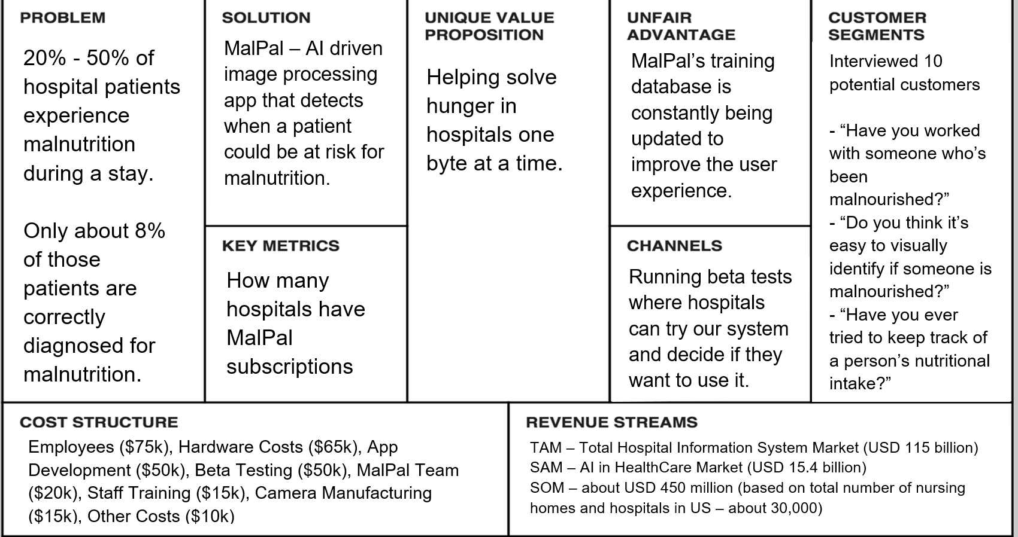
Lean Canvas Model
Notes:
Joe

